Slide 1
AR Indoor Navigation for
SKKU Suwon campus
team E: 김현호 마준서 안정민 조민구

Slide 2
Contents
App Flow and UI example (with figma)
AR Marker Recognition
AR Anchor
Mapping
To-do List Until Next Week
2/9

Slide 3
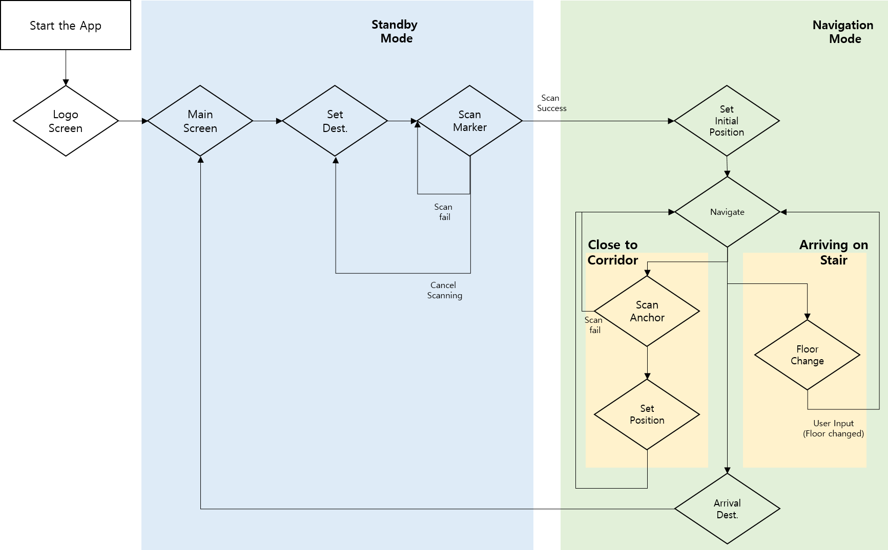
App Flow
3/9

Slide 4
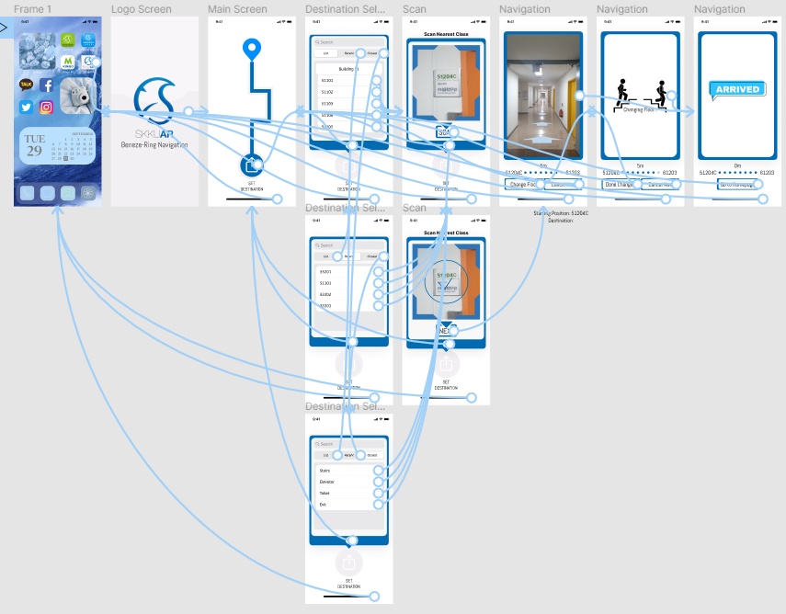
UI example with figma
4/9
https://www.figma.com/proto/ljQ1kmAVvCbNbwHbeZKvwk/Untitled?node-id=1%3A503&scaling=scale-down&page-id=0%3A1

Slide 5
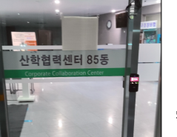
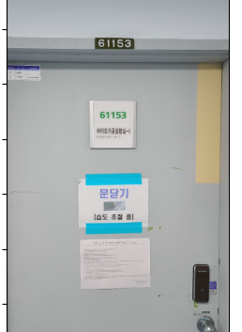
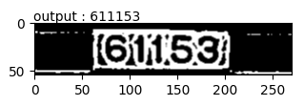
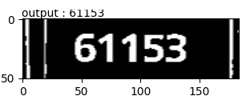
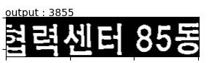
AR Marker Recognition Problem
5/9
figure 2
upper plate
figure 4
figure 3
lower plate
figure 5
figure 1
white text
hangeul translation

Slide 6
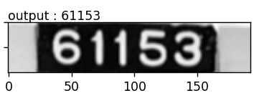
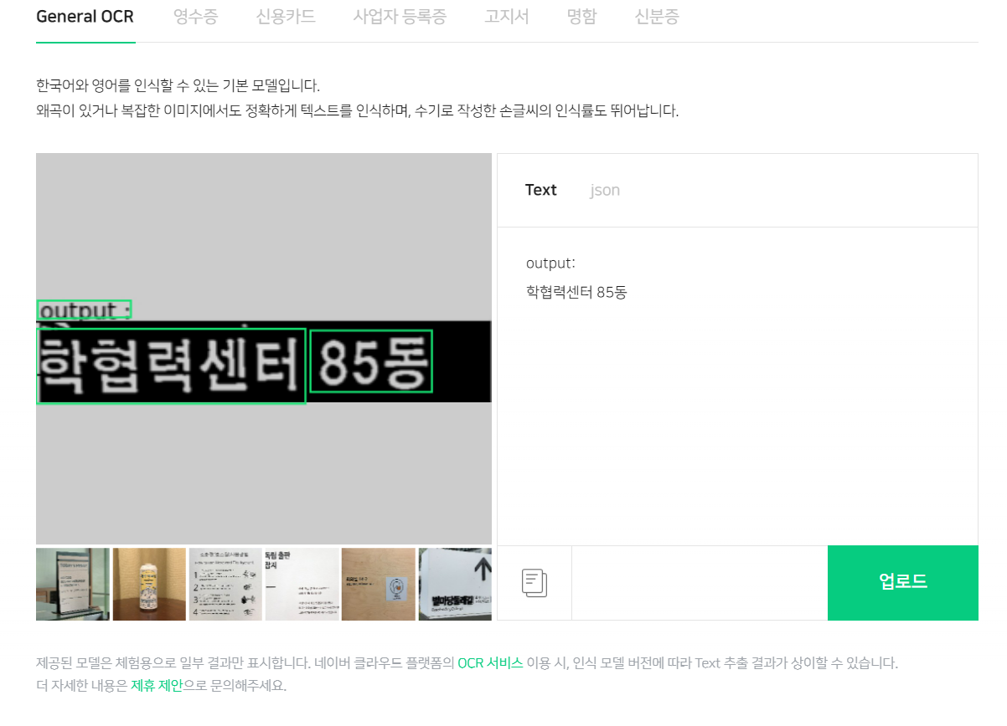
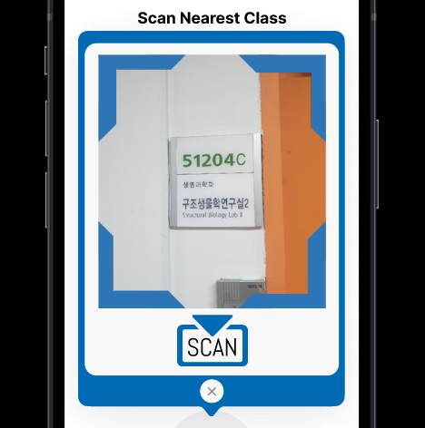
AR Marker Recognition Solution
6/9
figure 1
figure 2
figure 3

Slide 7
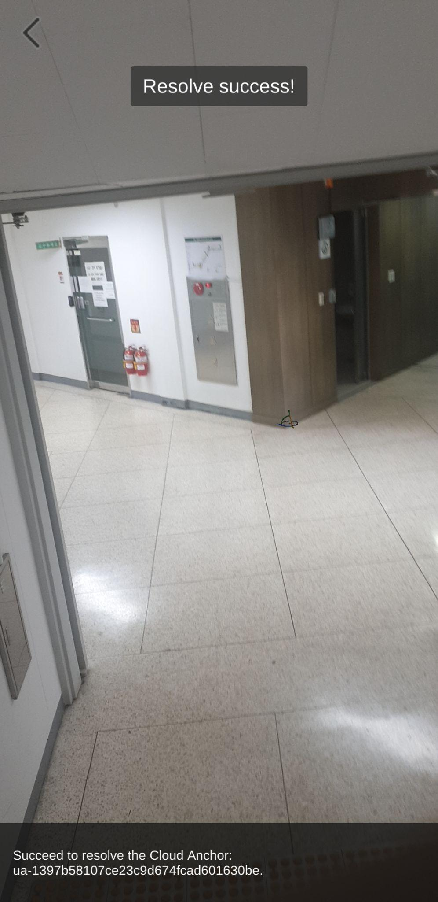
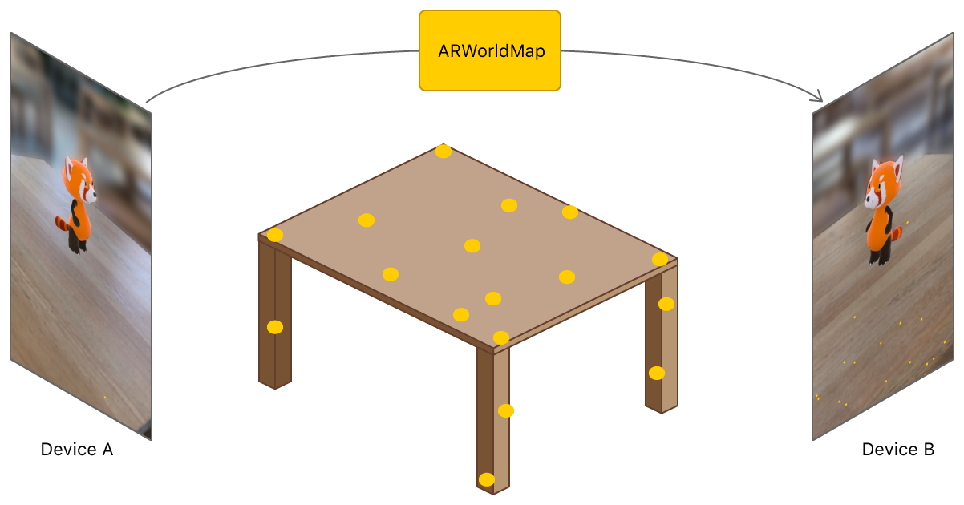

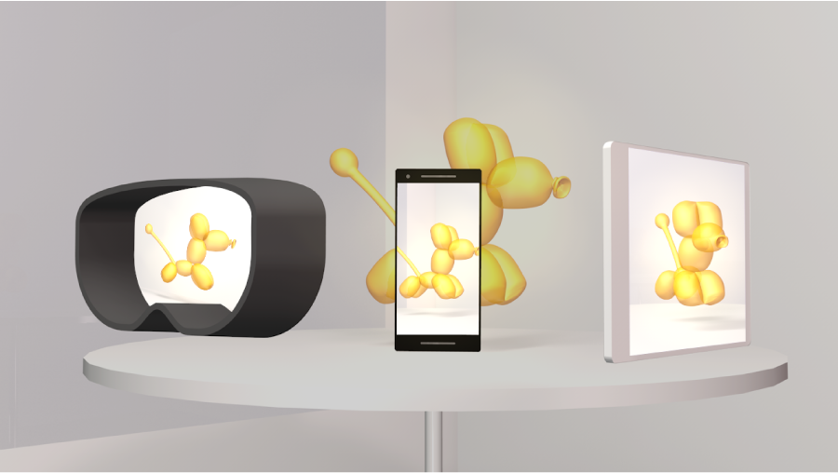
AR Anchor
7/9
Apple: AR kit - AR World Map
Google: AR core - AR Cloud Anchor
MicroSoft: Azure Spatial Anchor
Cloud Anchor test in campus

Slide 8
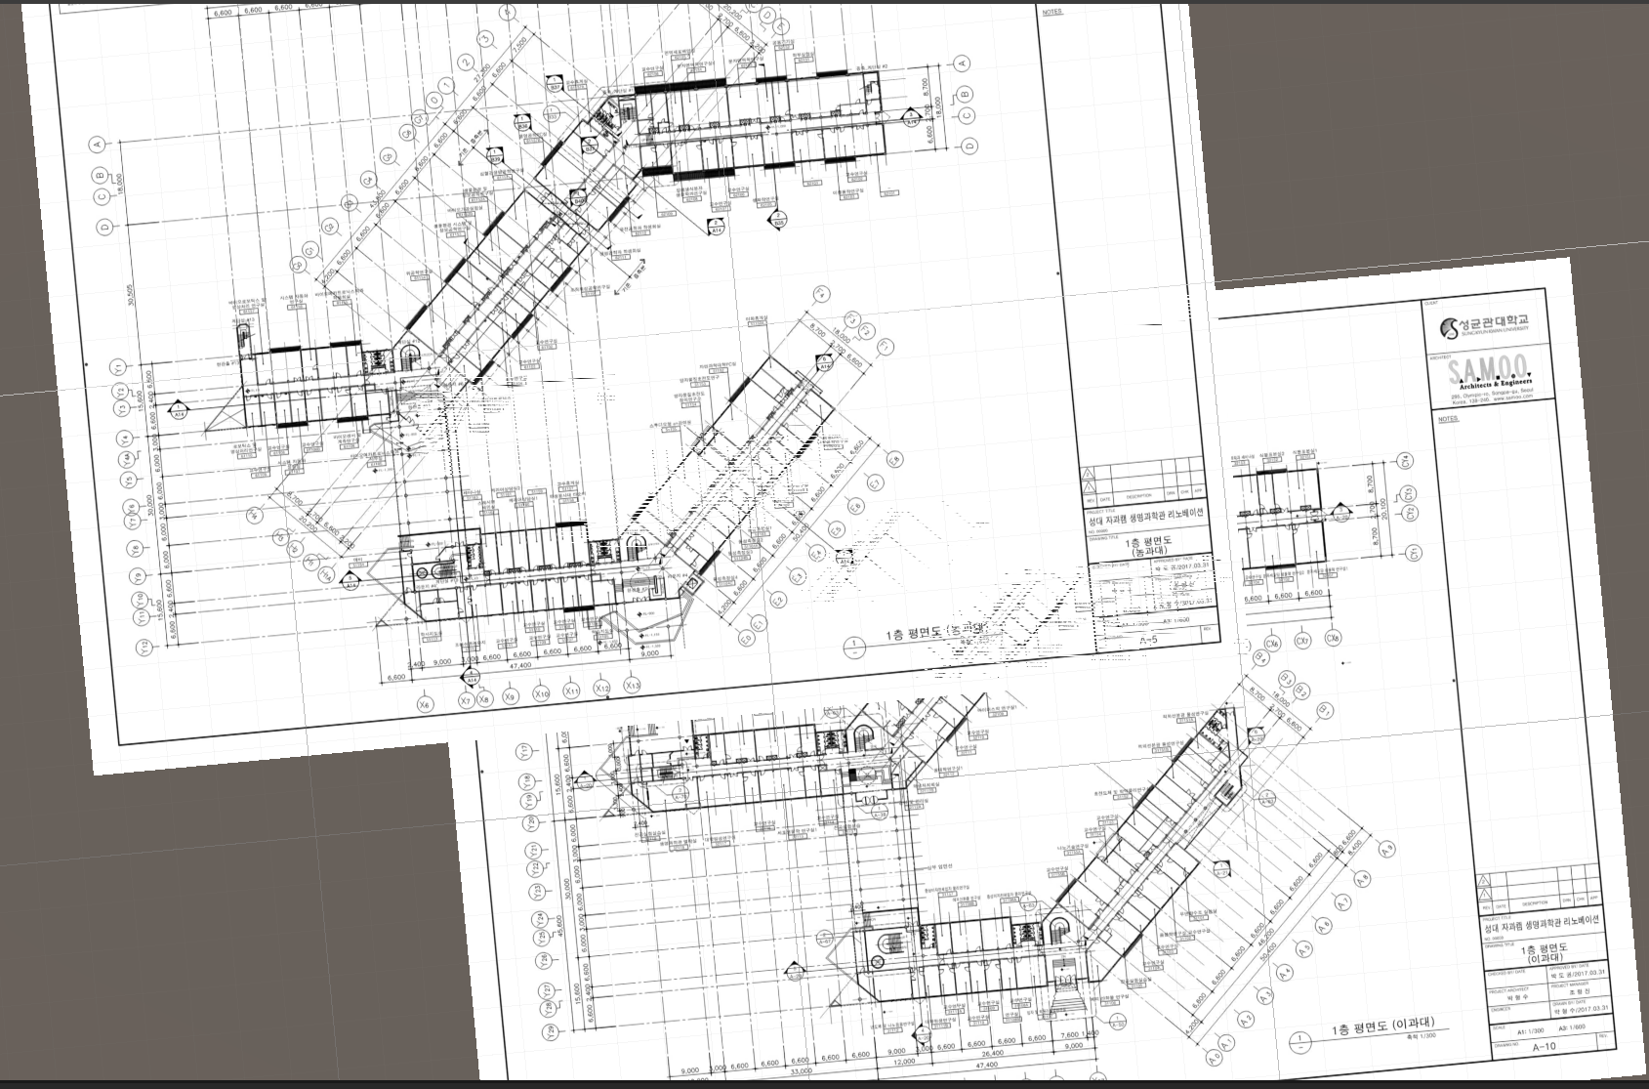
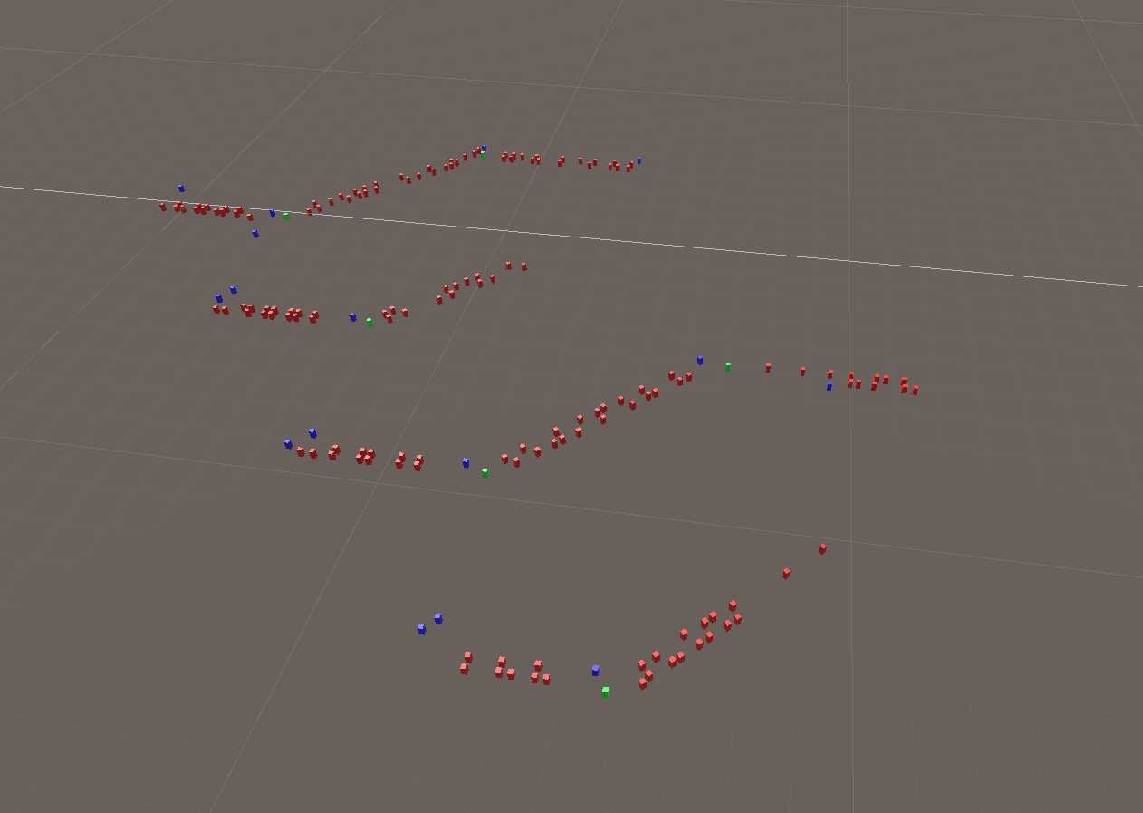
Mapping
8/9
Data Example
ID: 51120
Floor: 1F
Adjacent corridor: 51A
Position: 25, 128
…….

Slide 9
To-do List Until Next Week
Front-end development(progressing)
Mapped location error correction
Test AR marker initial localization with modeled map
Test AR anchor in unity environment
9/9

